Slide 1

Introduction to Robotics
2016 Fall

Slide 2
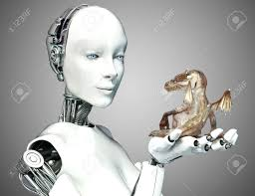
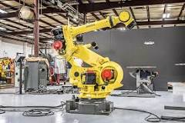
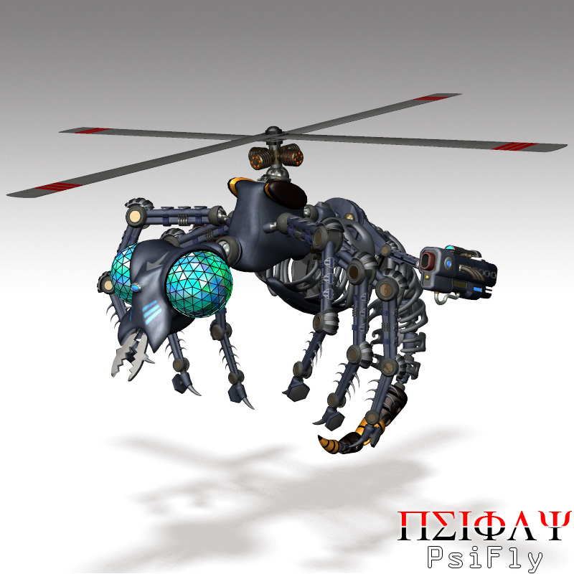
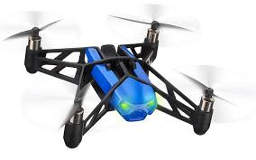
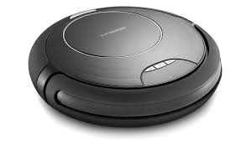
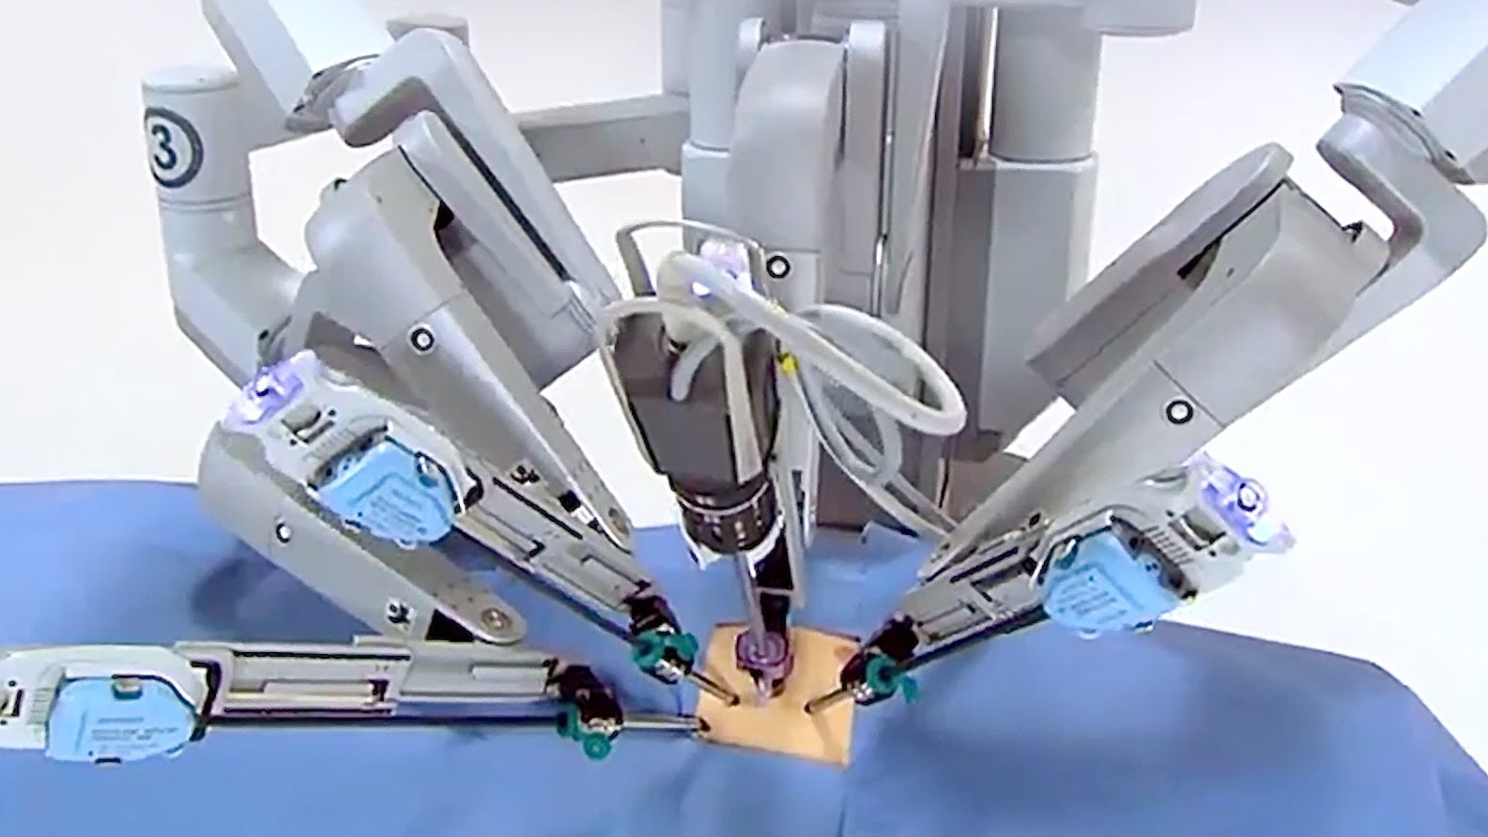
What is Robot?
A robot is a machine designed to execute one or more tasks automatically with speed and precision.
android
Industrial robot
insect robot
drone
Home cleaning robot
medical robot

Slide 3
Autonomous Robot
Autonomous robots do things all by themselves. They complete tasks with their own computers (called controller).
Robotics
Design, construction, operation, and application of robots.

Slide 4
mBot
http://www.makeblock.com/
https://www.youtube.com/watch?v=MFa8pYTUsFQ
https://www.youtube.com/watch?v=bhkjOldya5E
https://www.youtube.com/watch?v=p9543Fjx4sM

Slide 5
mBot
http://www.makeblock.com/
https://www.youtube.com/watch?v=MFa8pYTUsFQ
https://www.youtube.com/watch?v=bhkjOldya5E
https://www.youtube.com/watch?v=p9543Fjx4sM

Slide 6
mBot Assembly
https://www.youtube.com/watch?v=S6Ot2ShCulM

